Slide 1
Educate the Force: Enlisted Promotions

Slide 2
Purpose
Educate the enlisted force, starting at the lowest level, with the goal to improve understanding and knowledge regarding the MOARNG enlisted promotion system (EPS).

Slide 3
References
AR 600-8-19, Enlisted Promotions and Reductions
NGR 600-200, Enlisted Personnel Management
FY25 Enlisted Promotion System (EPS) Memorandum of Instruction (MOI)
MOARNG EPS Standard Operating Procedures (SOP)
Army National Guard (ARNG) Implementation Guidance for Suspension of Temporary Promotions and Select/Train/Educate /Promote (STEP) Policy and the Reduction of the On-Line Training (PPOM 24-014)

Slide 4
Recent Updates
SGT board will ONLY utilize administrative points (800 maximum)
SSG board will utilize administrative points (800 maximum) AND leadership points (250 maximum)
Voting rubric utilized for SSG, SFC, MSG, 1SG, SGM and CSM EPS boards
Suspension of Temporary Promotions
Distributed Learning Courses (DLC) I-VI have been eliminated

Slide 5
Responsibilities
Individual Soldier:
It is the responsibility of the Soldier to meet all eligibility requirements and to ensure that their record is up-to-date. If eligible, Soldiers will make their elections in IPPS-A and complete an EPS board consideration packet with the assistance of their first line leader (FLL) and full-time support personnel (FTS). A letter to the president of the board will need to be included to address any missing or erroneous documents in the Soldiers record.

Slide 6
Responsibilities
First Line Leader (FLL):
It is the responsibility of the FLL to ensure that their Soldiers are prepared by complying with the current published criteria. FLLs will assist in reviewing their Soldier’s records and preparing their EPS consideration packets. Assistance from FTS personnel is encouraged. FLLs must periodically counsel their Soldiers and provide accurate evaluations IAW AR 623-3 and DA PAM 623-3.
Full-Time Support (FTS) Personnel:
It is the responsibility of the FTS personnel to provide guidance and assist Soldiers and FLLs for accuracy and completeness of the EPS packets. They will prepare the finished copies ready for signatures and ensure that suspense dates are met. FTS personnel are responsible for ensuring that all documentation for personnel records updates are processed in a timely manner to ensure updates within the systems are completed prior to the promotion boards convening.

Slide 7
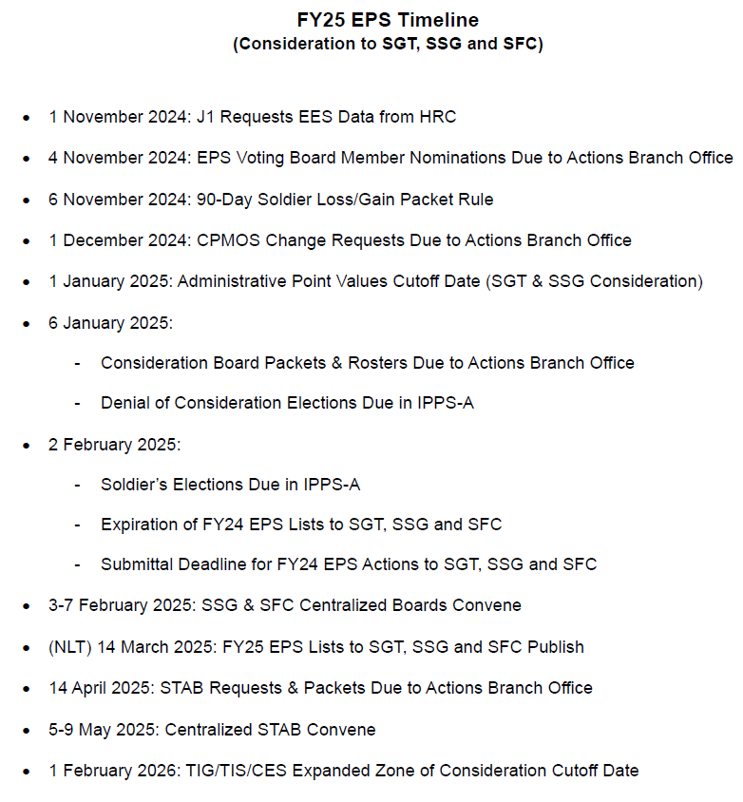
EPS Timelines

Slide 8
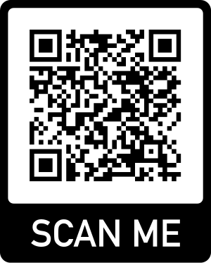
Vacancies and Position Opportunities
All referenced material can be found on the Missouri National Guard Website:

Slide 9
What is a Statewide Vacancy Announcement?

Slide 10
Statewide Vacancy Announcements (SWVA)
Designed to fill critical NCO vacancies which are unable to be filled through the EPS list
SGT-SGM vacancies are advertised statewide and can be found/received through email, the Missouri National Guard website, and your unit’s bulletin board
Soldiers that are 2 grades below the authorized grade for the advertised vacancy are authorized to apply
If selected, Soldiers that are not duty MOS qualified must agree to become duty MOS qualified within 1 year

Slide 11
Statewide Vacancy Announcements (SWVA)
Soldiers selected by SWVA must meet the following requirements for promotion:
Duty MOS qualified
PME complete for the applicable higher grade
Promotion list status

Slide 12
Automatic Promotions
For the ranks of:
Private Enlisted Two (PV2) – 6 months TIS
Private First Class (PFC) – 12 months TIS & 4 months as PV2
Specialist (SPC) – 24 months TIS & 6 months as PFC
Automatically processed by IPPS-A
Soldiers must be in good standing
Commanders may deny automatic promotions before a Soldier attains eligibility

Slide 13
Automatic Promotion Waivers
Commanders are authorized to waive TIS & TIG requirements to a lesser timeframe
For the ranks of:
Private Enlisted Two (PV2) – 4 months TIS
Private First Class (PFC) – 6 months TIS & 2 months as PV2
Specialist (SPC) – 18 months TIS & 3 months as PFC

Slide 14
Requesting EPS Board Consideration
All referenced material can be found on the Missouri National Guard Website:

Slide 15
Career Progression MOS (CPMOS)
By default, a Soldier’s CPMOS is their primary MOS. CPMOS is always for next grade, per CMF charts in DA PAM 611-21
If a Soldier wishes to compete in a different MOS that they are qualified in, a CPMOS change request is required
No matter if the Soldier was approved last cycle, must request again for this cycle. Only J-1 (COL Decker) can approve CPMOS Change Requests (paragraph 6-29d(2)(a) of AR 600-8-19)
EPS MOI timeline consists of CPMOS change submittal deadlines for each board.
Requests for CPMOS changes can only be submitted/approved during the pre-board process. After the deadline passes, Soldiers can only be moved from one CPMOS to another if they are placed into a different position with a different MOS in which they are qualified for (primary MOS matches duty position MOS)

Slide 16
Step #1
Board | TIG (Time in Grade) | TIS (Time in Service) | CES (Cumulative Enlisted Service) | Military Education Required
E8 | 36 months | 12 years | 8 years | Must have graduated Advanced NCO Course (ANCOC) or Senior Leader Course (SLC).
E7 | 36 months | 8 years | 6 years | Must have graduated Basic NCO Course (BNCOC) or Advanced Leader Course (ALC).
E6 | 18 months | N/A | N/A | Must have graduated Primary Leadership Development Course (PLDC), Warrior Leader Course (WLC) or Basic Leader Course (BLC).
E5 | 12 months | N/A | N/A | There is no PME requirement for promotion board eligibility or pin-on.
FY25 EPS MOI has the detailed dates and requirements listed in Enclosure 3

Slide 17
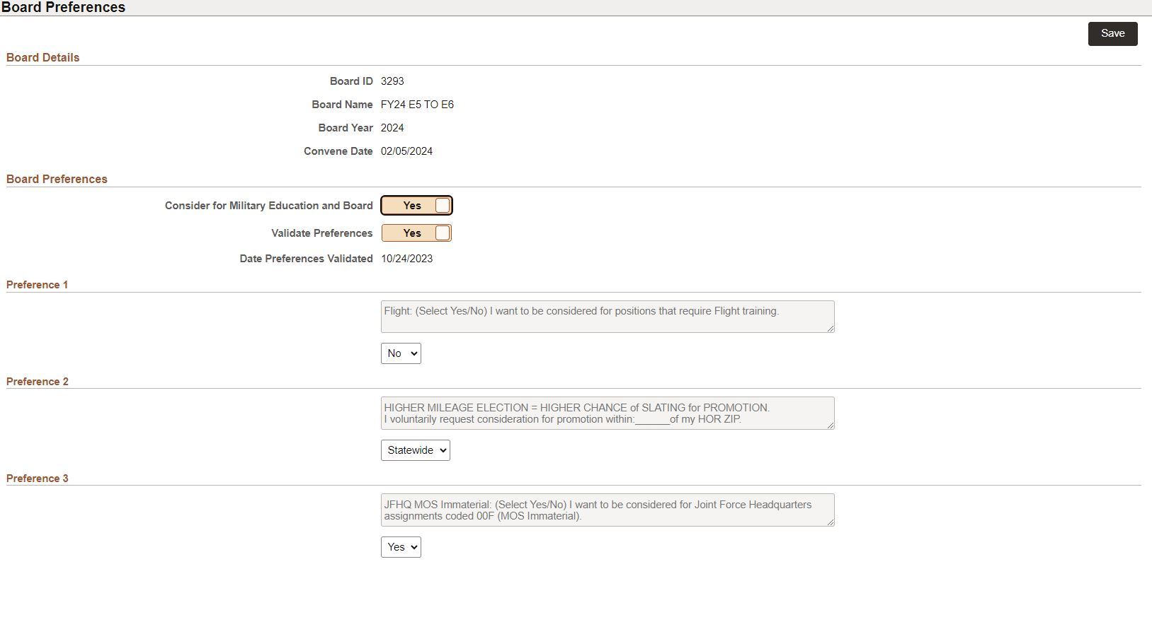
Step #2
Go to IPPS-A → “Self Service” page → click “Board Preferences USAR/ARNG”
Flight preference only pertains to 15T MOS

Slide 18
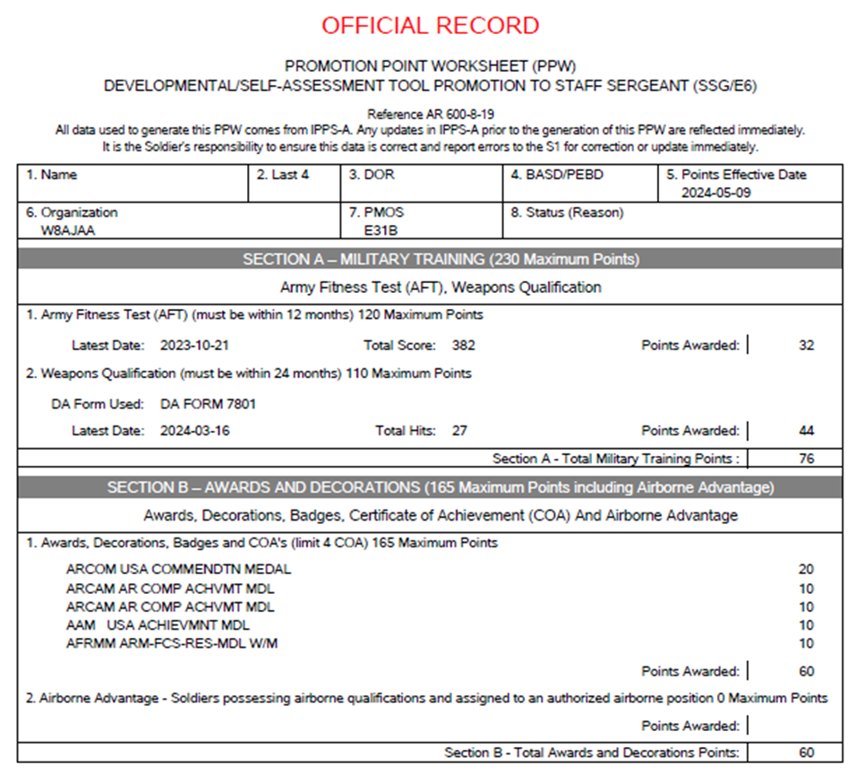
Step #3
Consideration to SGT and SSG ONLY:
Calculate your administrative points in your IPPS-A profile (guide available in the EPS SOP) and validate (with FTS) that the correct number of points are reflected on the personnel eligibility roster and promotion point worksheet (PPW)

Slide 19
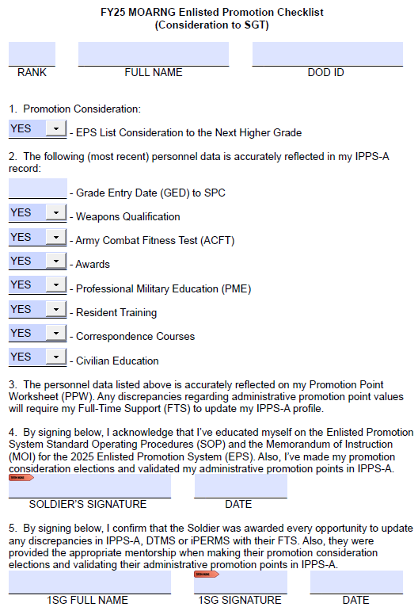
Step #4
Submit consideration packet using the appropriate EPS Checklist located on the MOGUARD website or provided by your FTS

Slide 20
Step #5
Submit EPS consideration packet to your CoC for 1SG review and signature.
Follow-up!

Slide 21
EPS Board Purpose
Evaluate each Soldier using the Whole Soldier Concept with the purpose of establishing a fair and impartial promotion list.

Slide 22
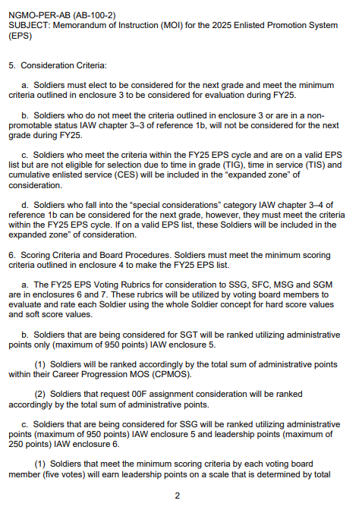
Understanding the EPS Board Process
FY25 EPS MOI has the detailed scoring criteria broken down by each rank in paragraph 6 and further explained in Enclosure 4

Slide 23
What is the Voting Rubric?
Outlines what the MOARNG is looking for when assessing the top, middle, and bottom NCOs within the MOARNG
Published in each annual EPS MOI (Enclosures 6, 7, & 8)
Career progression “Cheat Sheet” readily accessible to all Soldiers
Ensures equitable and consistent assessments are made on all records reviewed that will accurately reflect a Soldier’s board file based upon the established baseline criteria

Slide 24
Voting Rubric Scoring
Hard Point scoring of 0 through 4 and a Soft Point scoring of 0, 1 or 2.
Hard Point rating and its meaning:
4: top few Soldiers that are exceptional – top 10%
3: very strong performers that are ahead of their peers and perform well
2: strong performers that are qualified and responsible
1: satisfactory performance – may not be very experienced but shows potential
0: does not meet standards
Soft Point scoring and its meaning:
0: low rated if a tie-breaker occurs with hard points
1: middle rating if a tie-breaker occurs with hard points
2: highly rated if a tie-breaker occurs with hard points

Slide 25
Voting Rubric Scoring
Minimum score required for making the EPS Lists to SFC, MSG and SGM is 12 hard points out of 24 total (by each voting member)
Minimum score required for making the EPS List to SSG is 11 hard points out of 20 total (by each voting member)
Scoring a “0” in ANY hard score evaluation category will result in not making the EPS list
Failure to address and provide a letter to the president of the board for material discrepancies within the Soldier’s record could result in the hard score evaluation category rating being reduced by 1 point

Slide 26
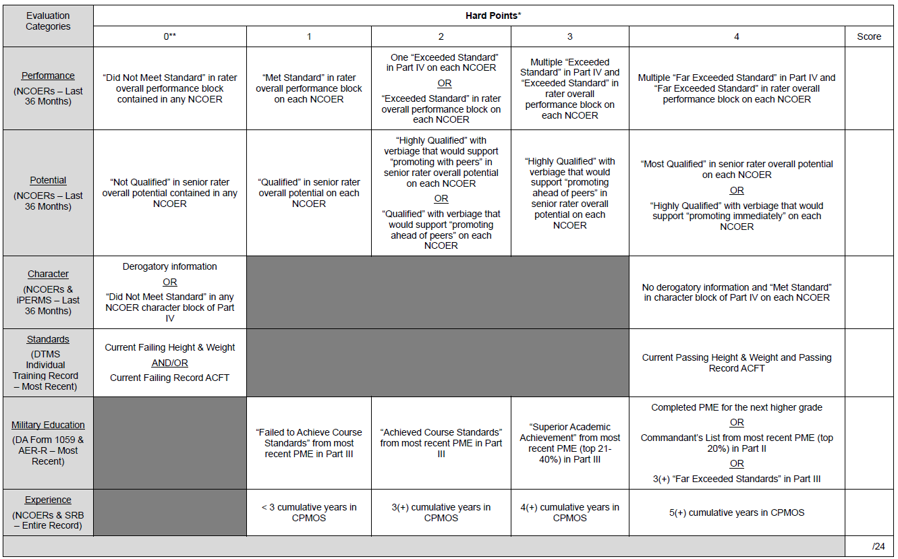
Hard Points (to SFC, MSG and SGM)

Slide 27
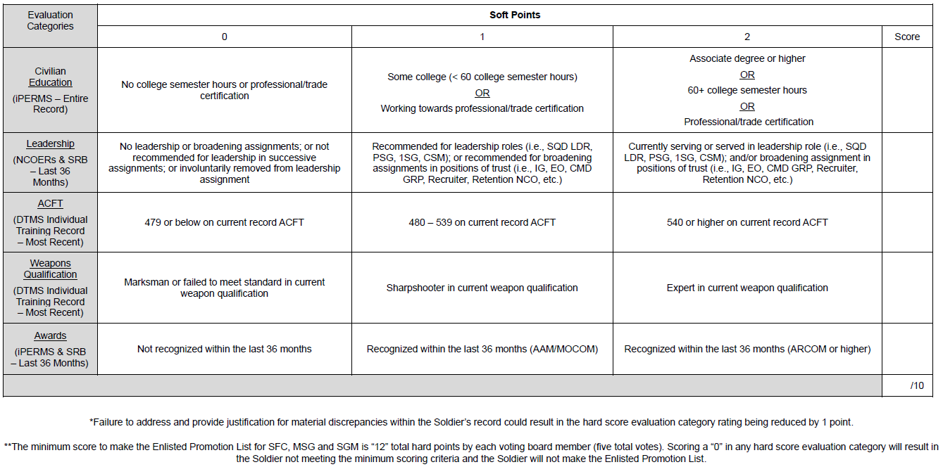
Soft Points (to SFC, MSG and SGM)

Slide 28
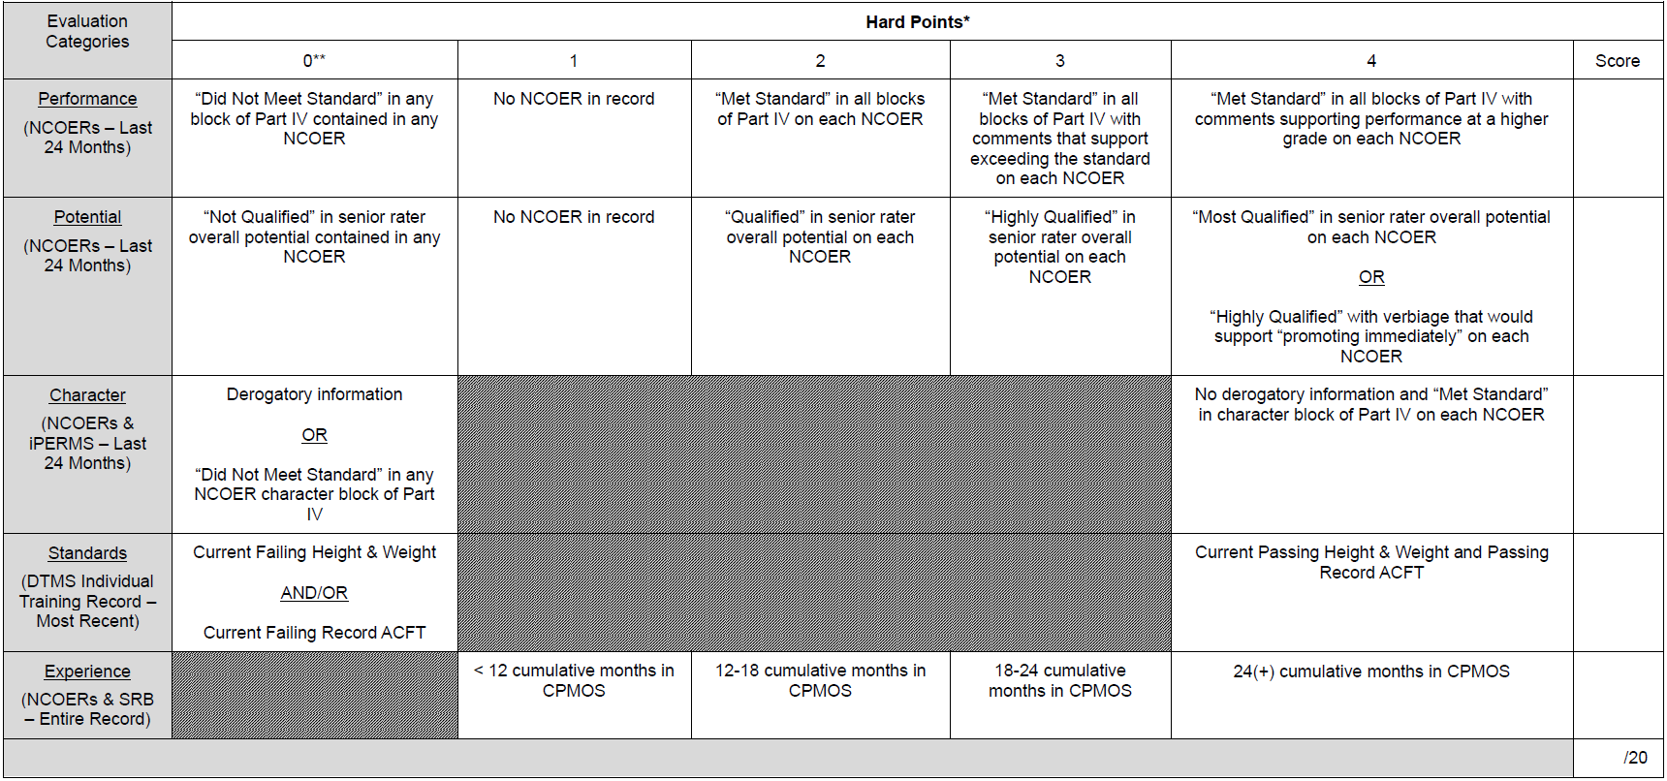
Hard Points (to SSG)

Slide 29
Soft Points (to SSG)

Slide 30
EPS Board Member Nomination
Reach out to your FLL and FTS to express your interest in participating as a board member in the upcoming EPS boards. Service on the EPS board is one of the most important duties an individual leader performs!

Slide 31
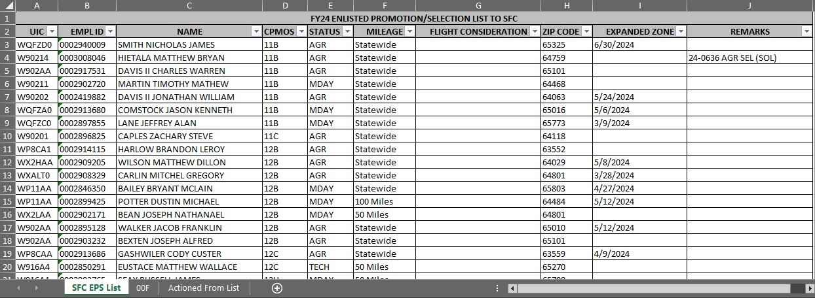
EPS List Content

Slide 32
Changes to ACFT Standards
Army Directive 2022-05, Army Combat Fitness Test (23 March 2022)
Traditional (M-Day):
Record ACFT required beginning 1 April 2024
One per calendar year (conducted every 8 – 14 months)
AGR & ADOS:
Two per calendar year (conducted every 4 – 8 months)
EPS Boards have now transitioned to scoring based on the current ACFT in a Soldier’s record

Slide 33
Changes to ABCP Standards
Army Directive 2023-08, Army Body Fat Assessment Exemption for ACFT Score (15 March 2023)
Army Directive 2023-11, Army Body Fat Assessment for the Army Body Composition Program (9 June 2023)
Army Directive 2022-06, Parenthood, Pregnancy, and Postpartum (19 April 2022)
All Soldiers:
Record weigh-in every 6 months (unless exempt under AD 2022-06)
Soldiers who score 540+ on ACFT (minimum of 80 points in each event) are exempt from body fat tape assessment
EPS Boards have now transitioned to scoring based on the current HT/WT in a Soldier’s record

Slide 34
Suspension of Temporary Promotions
Temporary promotions were suspended by the Army G-1 on 2 May 2024.
Implementation guidance from NGB published 7 June 2024.
Soldiers previously temporarily promoted will not revert to their former grade and are considered “permanently” promoted to their current grade.
This new policy does not undermine the importance of a Soldier’s attendance to a professional NCOPDS course (Basic Leader Course, etc.).

Slide 35
Suspension of STEP Policy
Select, Train, Educate, Promote (STEP) policy was suspended by the Army G-1 on 4 May 2024.
Implementation guidance from NGB published 7 June 2024.
Army will use the updated NCOPDS levels to qualify Soldiers for promotion:

Slide 36
Suspension of STEP Policy
To emphasize the importance of NCOPDS in sustaining a professional NCO Corps, an additional 150 promotion points will be added to Soldier’s total promotion point score for:
Soldiers recommended to SGT who are graduates of BLC
Soldiers recommended to SSG who are graduates of ALC

Slide 37
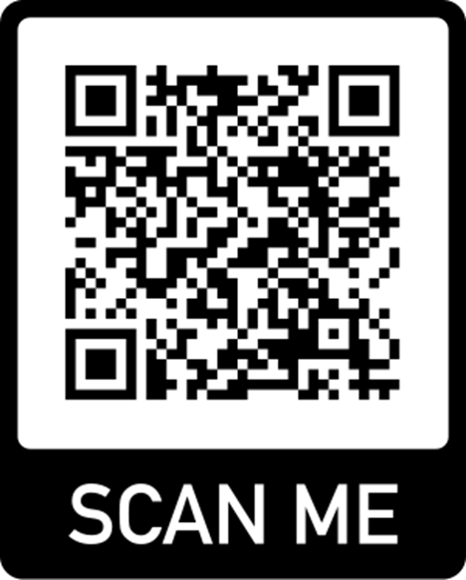
Questions?
Enlisted Promotion Manager: SSG Hunter Gladbach
hunter.a.gladbach.mil@army.mil
Assistant Enlisted Promotion Manager: SGT Kendall Kothe
kendall.p.kothe.mil@army.mil

